Slide 1

S E P T E M B E R 2 0 0 7
CVA: DYNAMIC CREDIT / MARKET RISK MANAGEMENT
Risk University
S T R I C T L Y P R I V A T E A N D C O N F I D E N T I A L

Slide 2

Introduction
Counterparty risk arises from derivative contracts where JP Morgan Chase may receive future positive cash flows. The ‘Credit Portfolio Group’ charge the business in exchange for taking on the Counterparty Credit exposure and providing insurance in case of default.
This charge (Credit Charge) is a function of the average expected amount the Counterparty is likely to owe us (Average Exposure), the time this exposure is carried for (Modified Duration) and the risk that the Counterparty fails to meet it’s obligations (Credit Spread).
Derivative Risk Equivalent (DRE) looks at 1 standard deviation move plus the riskiness of the Counterparty. Peak Exposure is the greatest, looking at 2 standard deviations and one tail test.
See Appendix 1 for a full definition of the different exposure types
D E R I V A T I V E S 1 0 1 T R A I N I N G - C V A, H E D G E S A N D P & L
2

Slide 3
Credit Valuation Adjustment - Expected Loss on Derivatives
The Credit Charge on a derivative transaction is also the ‘Expected Loss’. It is the ‘premium’ Marketers pay to buy insurance against a counterparty default when JPM is in the money. We work on a portfolio basis and, where applicable, exposure is netted with other exposure to the same counterparty. The credit charge reflects this portfolio effect and is also known as Credit Valuation Adjustment (CVA).
CVA = the adjustment to our Credit Portfolio reserve required to compensate for additional counterparty exposure risk.
The Marketers are billed upfront (actual billing is monthly) and incorporate this cost into their prices (i.e the Counterparty ultimately pays). Some desks are self-insured, and manage their own Counterparty risk.
The up front Credit Charge for a derivative is calculated using the following formula:
Upfront_CreditCharge = AverageExposure * ModDuration(T) * CreditSpread
D E R I V A T I V E S 1 0 1 T R A I N I N G - C V A, H E D G E S A N D P & L
3

Slide 4
SAMPRAS and Monte Carlo Simulation
SAMPRAS (Simulations Across Multiple Paths, Recalculations And Sorting) is the principal credit calculation engine for the firm’s OTC Derivative trading portfolio, with about 95% (850,000+ transactions) of the firm’s total external derivative population. It is a Monte Carlo Simulation engine
It re-values a portfolio of trades along maximum of 400 different paths
Uses market (implied) volatilities to stress portfolio along these different paths
Works out the probability of each event happening, and therefore allows us to calculate the Expected outcome and the Peak (97.5%) outcome
Incorporates netting and collateral, correlation
SAMPRAS sends results to Globalnet
CVA is calculated daily => daily P&L and Risk positions
D E R I V A T I V E S 1 0 1 T R A I N I N G - C V A, H E D G E S A N D P & L
4

Slide 5
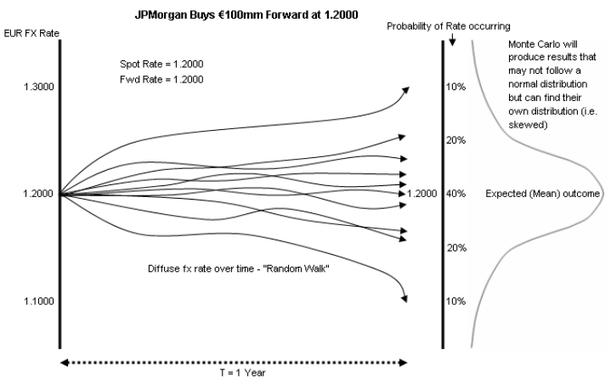
Predicting future exposure on derivatives
The future outcome of a derivative trade is not known at inception. All we know is the exposure at the start is zero (if the derivative is valued at market) and by definition, zero at maturity. The exposure between these points can only be estimated using probability-based calculations.
At the point just before maturity (T), the FX rate could be any number of possibilities.
D E R I V A T I V E S 1 0 1 T R A I N I N G - C V A, H E D G E S A N D P & L
5

Slide 6
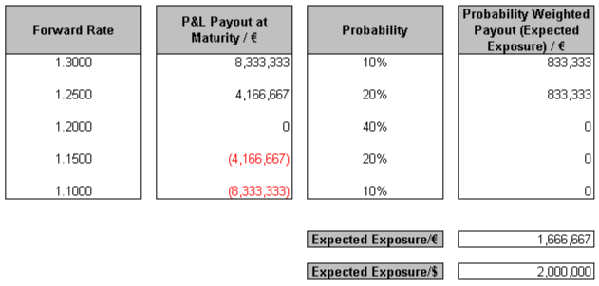
Probability-Weighted Average Market Value - Expected Exposure
The credit exposure of an FX Forward is zero at inception, and at it’s greatest the moment before maturity. If we look at the possible market values at the moment before the end of the contract (T), then we can build a simple probability tree to predict the Expected Exposure at this point.
Example: JPMorgan buys €100mm, 1 year, EUR/USD FX Fwd @ 1.2000
Note, we are only concerned with exposures where we are in the money (net receivers). The Expected Exposure is the probability weighted average market value, where we are in the money.
The Average Exposure is simply the mean of the Expected Exposures across the trade’s life.
D E R I V A T I V E S 1 0 1 T R A I N I N G - C V A, H E D G E S A N D P & L
6

Slide 7
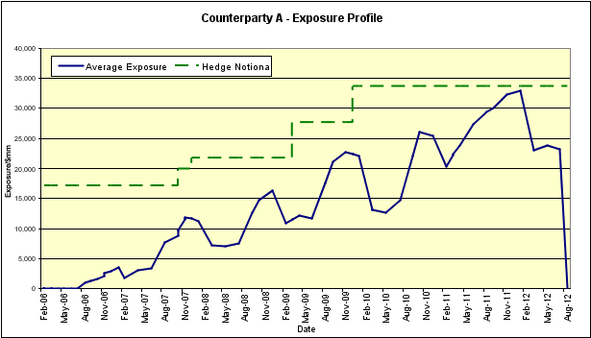
Credit and Market Hedges
Counterparty Exposure is sensitive to moves in Credit Spreads of the derivative Counterparties. To hedge against spread widening, Credit Portfolio can buy a Credit Default Swap (CDS) on the counterparty (or a proxy hedge if the counterparty credit doesn’t trade).
Similarly, the exposure is also sensitive to moves in the underlying market – FX and Interest Rates being the largest. Credit Portfolio can choose to hedge the exposure through transactions in the underlying market – transactions such as Spot FX or Interest Rate Swaps.
The CVA covers the cost of credit and market hedges.
D E R I V A T I V E S 1 0 1 T R A I N I N G - C V A, H E D G E S A N D P & L
7

Slide 8
CVA Market Risks
What do we mean by Delta on the CVA?
How does CVA change when market moves 1%?
What do we mean by Gamma? Where does it come from?
What if market moves up 10% or down 10%, why isn’t move symetrical?
What is Vega? Where does this come from?
What is CVA for Eur/Chf swap? Or USD/ZAR?
How do we measure these risks?
How do we hedge our exposure to these risks?
What is the risk profile of futures, forwards, swaps, spot fx
How will their MTM change as the market moves?
How is the profile different for options?
8

Slide 9
CVA Market Risks – approach 2
If JPM receives XYZ for risky corporate (#1) in a swap, it will try hedge that exposure by selling XYZ to another, call it counterpart #2.
If #1 defaults, we won’t receive enough XYZ to pass on to #2.
In anticipation of this, we’ll build an inventory of XYZ as #1 approaches default. As risk of default decreases we’ll sell it out.
The delta on this inventory should be the appropriate delta to hedge the CVA (note that the CVA delta will increase as spreads increase).
9

Slide 10
Conclusion
Credit Portfolio manage the Counterparty risk associated with the In-The-Money component of the firm’s OTC derivatives portfolio
SAMPRAS generates the credit charge (CVA), which is a representation of this risk, through Monte Carlo Simulation over multiple paths
CPG may spend that CVA on a wide variety of Credit or Market-based hedging instruments depending on the nature of the underlying trade(s) and/or liquidity
D E R I V A T I V E S 1 0 1 T R A I N I N G - C V A, H E D G E S A N D P & L
12

Slide 11
Appendix 1 - Exposure definitions
Expected Exposure: to overcome not knowing how much a contract will be worth to us in the future, and therefore the credit risk, we can calculate future values under different scenarios and find the probability weighted average of these possible outcomes. This is known as the Expected Exposure, and relates to one moment in time. We can calculate Expected Exposure, at various points, to build up a exposure profile
Average Exposure: the Average Exposure is simply the mean of the Expected Exposures, across the trade’s life.
Derivative Risk Equivalent Exposure: the DRE is the Expected Exposures, at each point plus 1 SD factor to reflect the unexpected exposure, factored by the riskiness of the counterparty. This can be seen as a loan equivalent exposure. DRE is effectively the exposure at a 68% Confidence Interval. The Counterparty default probability is only a minor effect on the exposure number. The formula for DRE is as follows:
DRE = SQRT[Average Exposure^2 + (1 SD^2 / (1-EDF)]
Peak Exposure: Peak Exposure, like Expected Exposure relates to a moment in time. However, Peak Exposure is the near maximum exposure (given a certain confidence interval) that could arise at that particular moment during the trade. As with Expected Exposure, the Peak exposure can be model over the life of the trade. JPM Chase use a 97.5% Confidence Interval (two standard deviations - one tail test) to calculate Peak Exposure
D E R I V A T I V E S 1 0 1 T R A I N I N G - C V A, H E D G E S A N D P & L
13

